Slide 1
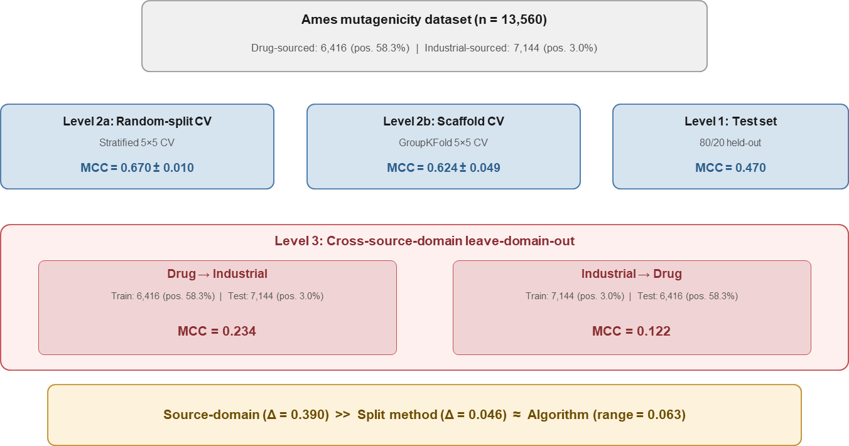
Ames mutagenicity dataset (n = 13,560)
Drug-sourced: 6,416 (pos. 58.3%) | Industrial-sourced: 7,144 (pos. 3.0%)
Level 2a: Random-split CV
Level 2b: Scaffold CV
Level 1: Test set
Stratified 5×5 CV
GroupKFold 5×5 CV
80/20 held-out
MCC = 0.670 ± 0.010
MCC = 0.624 ± 0.049
MCC = 0.470
Level 3: Cross-source-domain leave-domain-out
Drug → Industrial
Industrial → Drug
Train: 6,416 (pos. 58.3%) | Test: 7,144 (pos. 3.0%)
Train: 7,144 (pos. 3.0%) | Test: 6,416 (pos. 58.3%)
MCC = 0.234
MCC = 0.122
Source-domain (Δ = 0.390) >> Split method (Δ = 0.046) ≈ Algorithm (range = 0.063)

